Slide 1
Scientific Text Mining and Knowledge Graphs Chapter 1 Part 4: Scientific Statements
Presenter: Meng Jiang
University of Notre Dame
mjiang2@nd.edu
Notes:
Thank you for the introduction!
Good morning, everyone!
This is Jingbo Shang from UIUC. I’m very excited to share my research with you!
My talk today is mainly about AutoNet. Automated Network Construction from Massive Text Corpora.

Slide 2
Two Works
Extracting conditional statements for biomedical literature (KDD’19, EMNLP’19, TCBB)
Extracting experimental evidence for data science (WWW’20)
Scientific Statement
Conditions of Observation
Experimental Evidence

Slide 3
Two Works
Extracting conditional statements for biomedical literature (KDD’19, EMNLP’19, TCBB)
Extracting experimental evidence for data science (WWW’20)
Scientific Statement
Conditions of Observation
Experimental Evidence

Slide 4
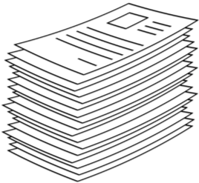
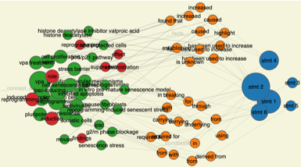
Structuring Text into Knowledge Graph
Given “LeBron James is returning to Miami Heat…”
Find fact tuple: (LeBron James, is returning to, Miami Heat)
ML
is returning to
Scientific literature
Scientific knowledge graph
LeBron James
Miami Heat
Unstructured
Structured
Named entities

Slide 5
Science IE: Conditional Statements
“We showed that extracellular acidic pH reduces the activity of TRPV5/V6 channels, whereas alkaline pH increases the activity of TRPV5/V6 channels in Jurkat T cells.”
Fact tuple 1: (extracellular acidic pH, reduces, {TRPV5/V6 channels: activity})
Fact tuple 2: (alkaline pH, increases, {TRPV5/V6 channels: activity})
Condition tuple: (TRPV5/V6 channels, in, Jurkat T cells)
“During T lymphocyte activation as well as production of cytokines, …”
Condition tuple 1: (-, during, {T lymphocyte: activation})
Condition tuple 2: (-, during, {cytokines: production})

Slide 6
Three-Level Scientific KGs
Fact tuple 1: (extracellular acidic pH, reduces, {TRPV5/V6 channels: activity})
Fact tuple 2: (alkaline pH, increases, {TRPV5/V6 channels: activity})
Condition tuple: (TRPV5/V6 channels, in, Jurkat T cells)
fact
Stmt
condition
fact
subj.
obj.
reduces
subj.
obj.
in
subj.
obj.
increases
extracellular acidic pH
alkaline pH
activity
TRPV5/V6 channels
Jurkat T cells

Slide 7
Three-Level Scientific KGs (cont’d)
“During T lymphocyte activation as well as production of cytokines, …”
Condition tuple 1: (-, during, {T lymphocyte: activation})
Condition tuple 2: (-, during, {cytokines: production})
Stmt
fact
condition
condition
obj.
during
during
obj.
activation
production
T lymphocyte
cytokines

Slide 8
Sequence Labeling for IE
input
We | showed | that | extracellular | acidic | pH | reduces | the | activity | of | TRPV5/V6 | channels | ,
O | O | O | B-f1C | I-f1C | I-f1C | B-f2P | O | B-f3A | O | B-f3C | I-f3C | O
output1
“Begin”
“Concept”
“Predicate”
“object”
“subject”
“relation”
“Attribute”
“fact”
whereas | alkaline | pH | increases | the | activity | of | TRPV5/V6 | channels | in | Jurkat | T | cells | .
O | O | O | O | O | O | O | O | O | O | O | O | O | O
Fact tuple 1: (extracellular acidic pH, reduces, {TRPV5/V6 channels: activity})

Slide 9
Multi-Output Sequence Labeling
We | showed | that | extracellular | acidic | pH | reduces | the | activity | of | TRPV5/V6 | channels | ,
O | O | O | B-f1C | I-f1C | I-f1C | B-f2P | O | B-f3A | O | B-f3C | I-f3C | O
O | O | O | O | O | O | O | O | O | O | O | O | O
O | O | O | O | O | O | O | O | O | O | O | O | O
whereas | alkaline | pH | increases | the | activity | of | TRPV5/V6 | channels | in | Jurkat | T | cells | .
O | O | O | O | O | O | O | O | O | O | O | O | O | O
O | B-f1C | I-f1C | B-f2P | O | B-f3A | O | B-f3C | I-f3C | O | O | O | O | O
O | O | O | O | O | O | O | B-c1C | I-c1C | B-c2P | B-c3C | I-c3C | I-c3C | O
Fact tuple 1: (extracellular acidic pH, reduces, {TRPV5/V6 channels: activity})
Fact tuple 2: (alkaline pH, increases, {TRPV5/V6 channels: activity})
Condition tuple: (TRPV5/V6 channels, in, Jurkat T cells)

Slide 10
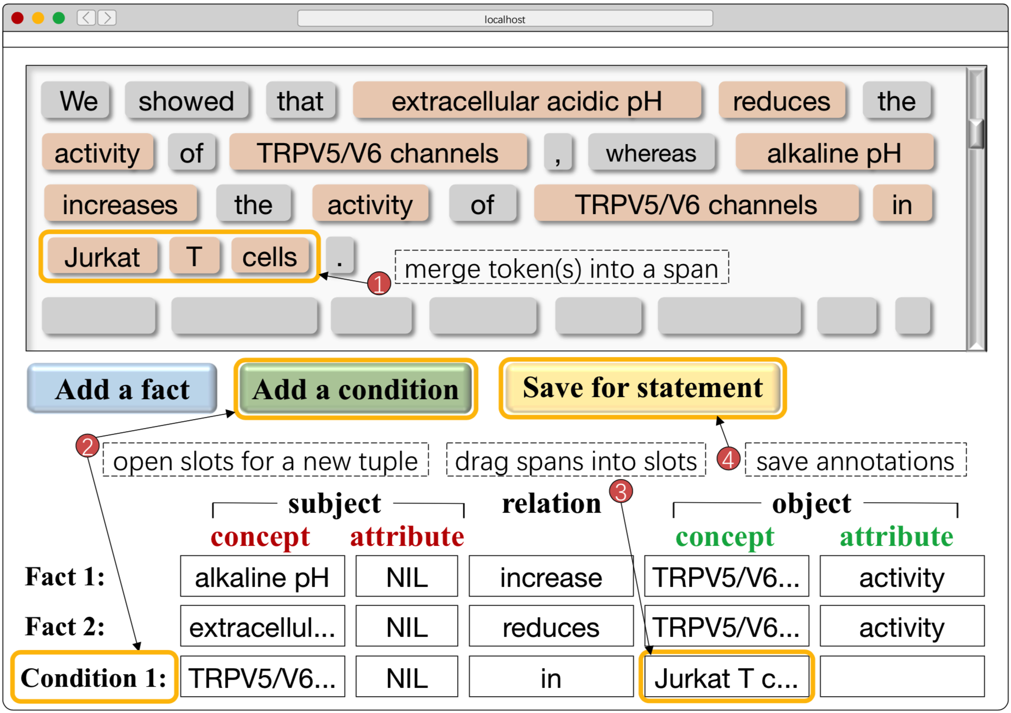
Sequence Labels
B-f1C | I-f1C | B-c1C | I-c1C
B-f1A | I-f1A | B-c1A | I-c1A
B-f2P | I-f2P | B-c2P | I-c2P
B-f3C | I-f3C | B-c3C | I-c3C
B-f3A | I-f3A | B-c3A | I-c3A
O
3 expert annotators
31 PubMed paper abstracts (docs)
> 30 minutes per anno. per doc
336 statement sentences
756 fact tuples
654 condition tuples

Slide 11
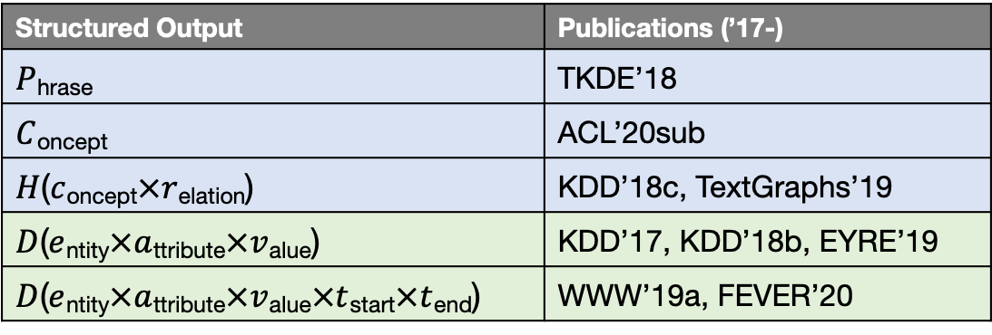
More Signals from Massive Data
Unlabeled data
15,544,338 documents
140,949,399 statement sentences
Feature extraction
Tokenization
Part-of-speech tagging
Phrase mining
Concept detection
Attribute discovery
…
Structured Output | Publications (’17-)
$P$_{hrase} | TKDE’18
$C$_{oncept} | ACL’20sub
$H$($c$_{oncept}$×r$_{elation}) | KDD’18c, TextGraphs’19
$D$($e$_{ntity}$×a$_{ttribute}$×v$_{alue}) | KDD’17, KDD’18b, EYRE’19
$D$($e$_{ntity}$×a$_{ttribute}$×v$_{alue}$×t$_{start}$×t$_{end}) | WWW’19a, FEVER’20

Slide 12
Multi-Input Multi-Output Sequence Labeling
whereas | alkaline | pH | increases | the | activity | of | TRPV5/V6 | channels | in | Jurkat | T | cells | .
NNS | NN | NN | VBZ | DT | NN | IN | NNP | NNS | IN | NNP | NNP | NNS | .
O | B-P | I-P | O | O | B-A | O | B-C | I-C | O | B-C | I-C | I-C | O
O | O | O | O | O | O | O | O | O | O | O | O | O | O
O | B-f1C | I-f1C | B-f2P | O | B-f3A | O | B-f3C | I-f3C | O | O | O | O | O
O | O | O | O | O | O | O | B-c1C | I-c1C | B-c2P | B-c3C | I-c3C | I-c3C | O
MIMO (BiLSTM/BERT)

Slide 13
Evaluation
 | Token Label Prediction (%) |  |  | Tuple Extraction (%)
 | P | R | F1 / fact, cond. | P | R | F1 / fact, cond.
Allennlp OpenIE (Stanovsky et al. 2018) | - | - | - | 42.60 | 38.22 | 40.29 / -, -
Stanford OpenIE (Angeli et al. 2015) | - | - | - | 47.11 | 41.62 | 44.19 / -, -
Structured SVM (Tsochantaridis et al. 2015) | 32.68 | 25.80 | 28.83 / 32.76, 24.71 | 47.62 | 46.15 | 46.87 / 45.01, 48.72
CRF (Lafferty et al. 2001) | 60.07 | 41.92 | 49.37 / 56.23, 41.87 | 65.19 | 62.44 | 63.78 / 64/07, 63.44
BiLSTM-LSTMd (Zheng et al. 2017) | 61.00 | 56.26 | 58.53 / 65.16, 51.78 | 71.57 | 66.55 | 68.97 / 69.51, 68.41
MO (BiLSTM based) | - | - | - | 71.80 | 72.34 | 72.07 / 72.39, 71.73
MIMO (BiLSTM based) | 67.80 | 58.24 | 62.66 / 66.67, 58.58 | 75.35 | 74.67 | 75.01 / 74.91, 75.10
BERT-BiLSTM | 70.07 | 70.19 | 70.13 / 74.30, 65.88 | 78.64 | 73.67 | 76.08 / 76.14, 75.99
MO (BERT based) | - | - | - | 77.38 | 79.19 | 78.27 / 76.74, 79.89
MIMO (BERT based) | 75.91 | 71.08 | 73.41 / 76.01, 70.75 | 81.06 | 80.53 | 80.79 / 79.94, 81.64

Slide 14
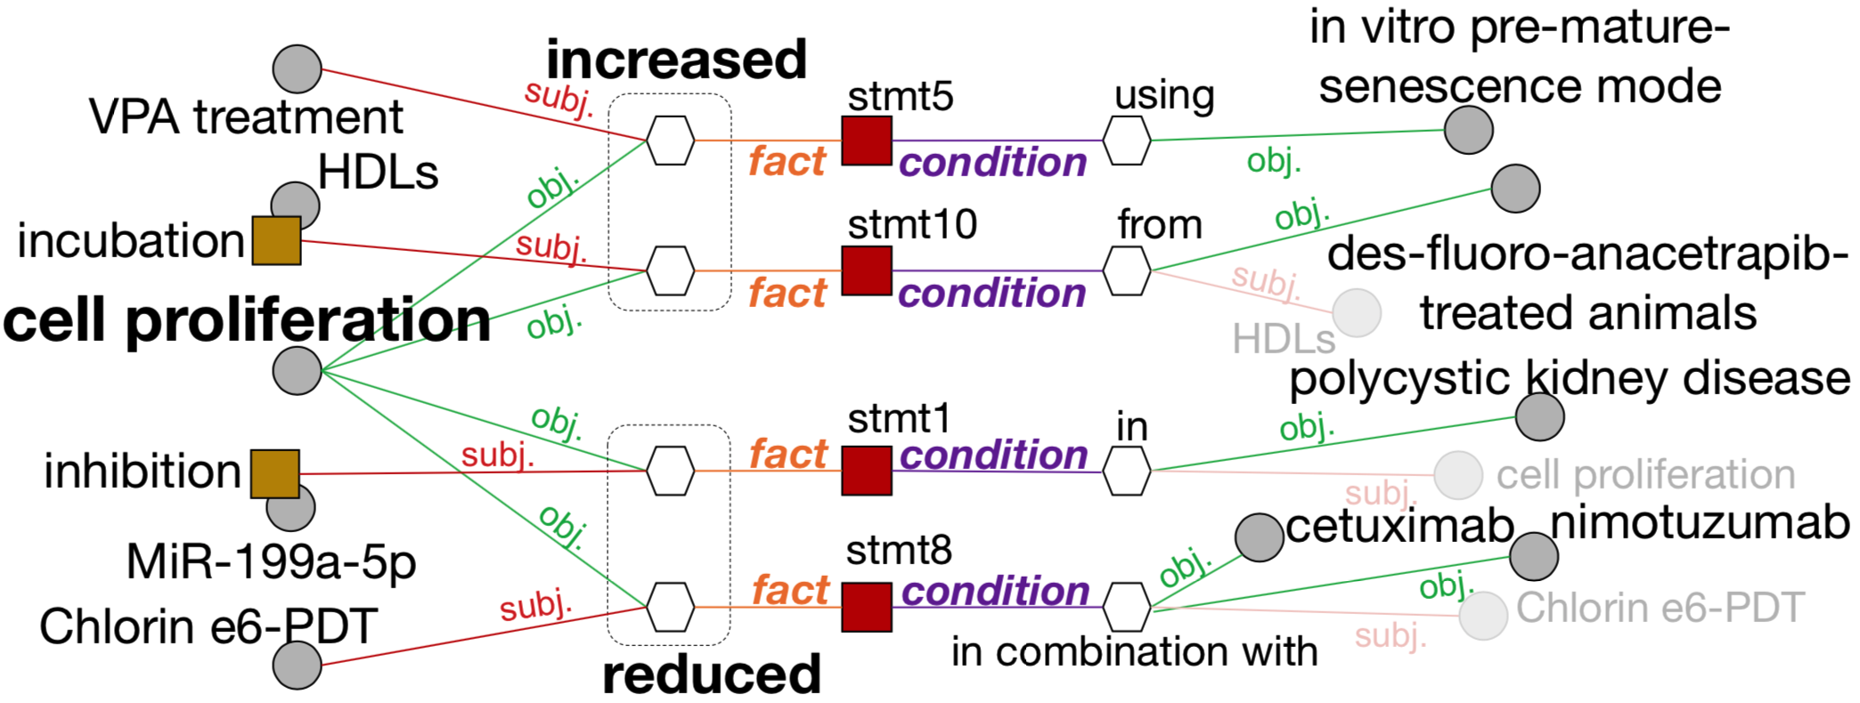
Case Study

Slide 15
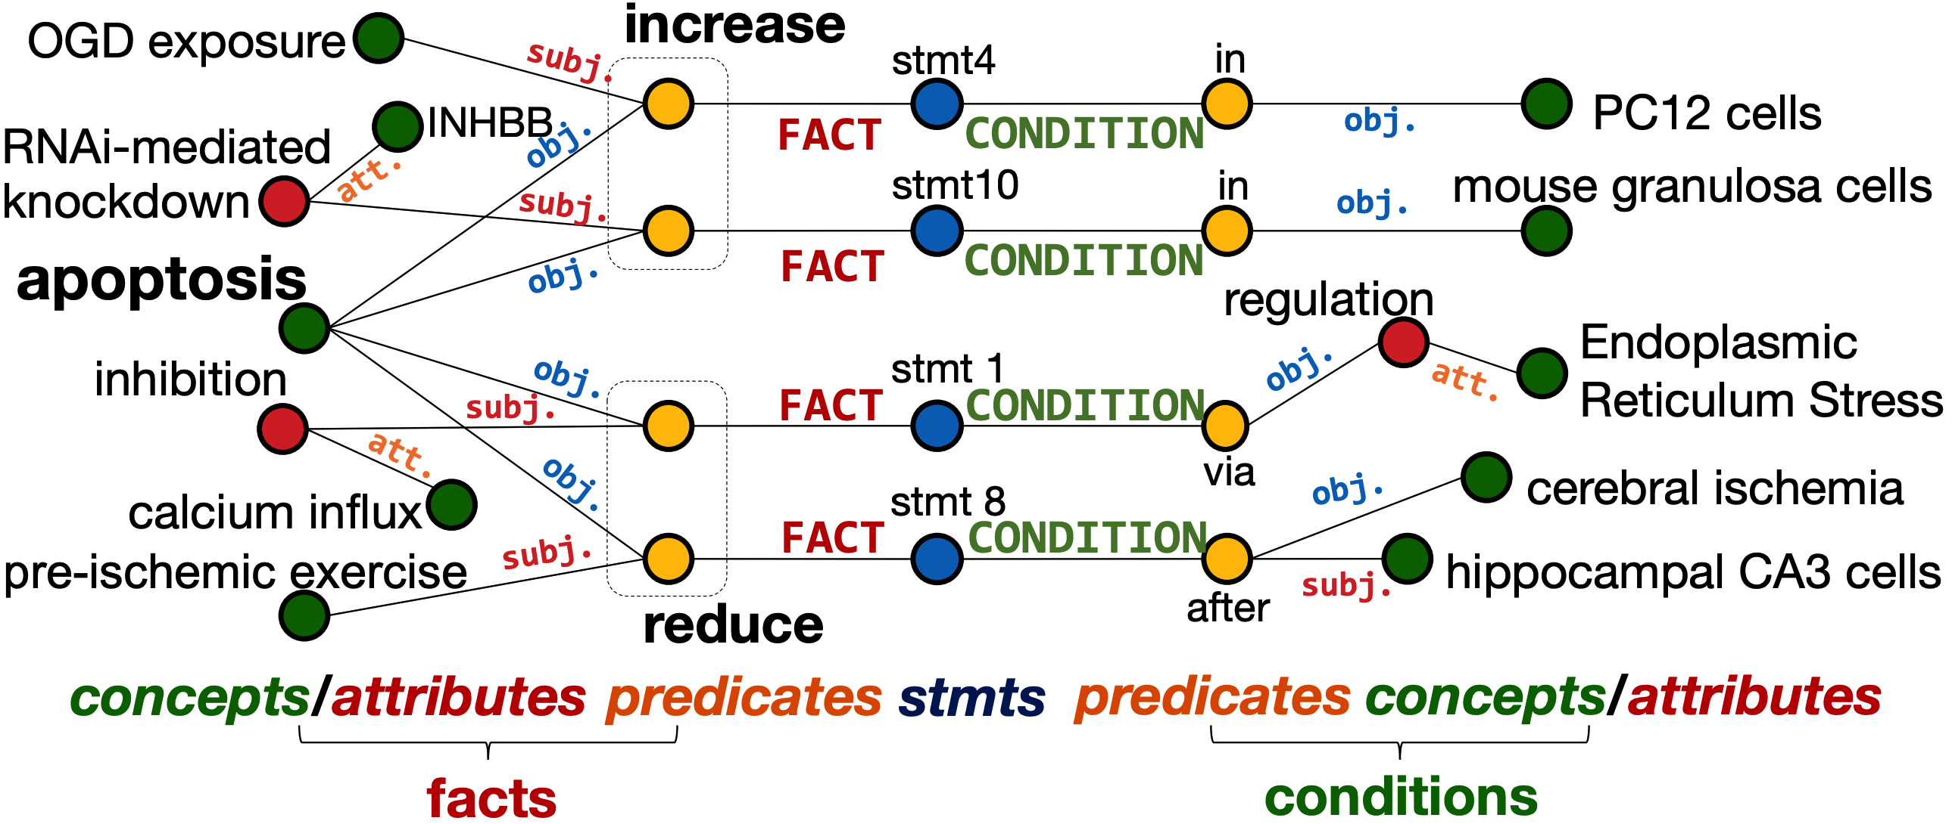
Case Study (cont’d)

Slide 16
Two Works
Extracting conditional statements for biomedical literature (KDD’19, EMNLP’19, TCBB)
Extracting experimental evidence for data science (WWW’20)
Scientific Statement
Conditions of Observation
Experimental Evidence

Slide 17
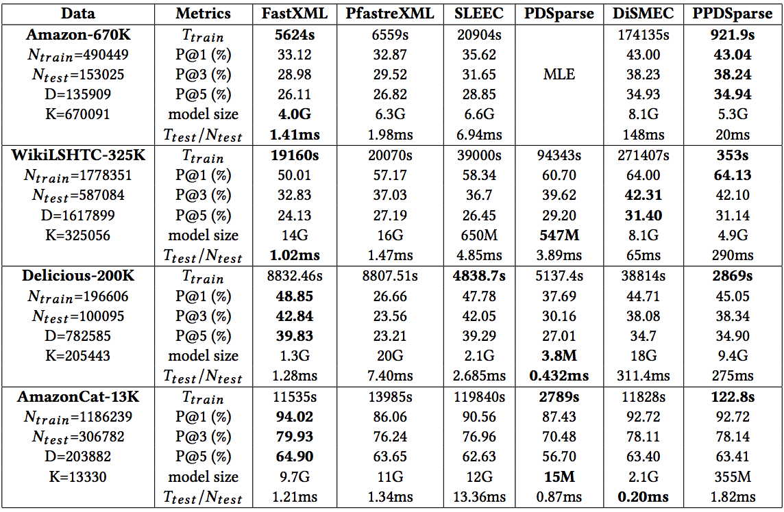
Motivation
PPDSparse: A Parallel Primal-Dual Sparse Method for Extreme Classification
by CMU, UT Austin, Pentuum [KDD 2017]

Slide 18
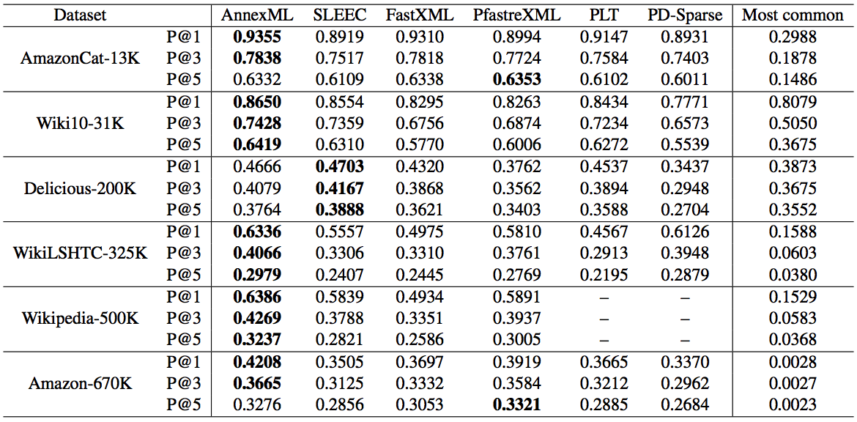
Motivation (cont’d)
AnnexML: Approximate Nearest Neighbor Search for Extreme Multi-label Classification
by Yahoo Japan Corporation [KDD 2017]

Slide 19
Motivation (cont’d)

Slide 20
Motivation
On dataset, method makes a metric
of XXX (score) on the task.
Experimental
evidence
Literature survey
Method design
…
Component
Definition
Usage
What are the datasets we can use?
How do people evaluate the methods?
What is the “state-of-the-art”?
…
Research study
Extreme
(multi-label)
classification
Recommender
systems
……
Goal
Research problems
Experimental Evidence Extraction System in Data Science with Hybrid Table Features and Ensemble Learning
Develop a computational method to build the system
Feature extraction
Learning strategies

Slide 21
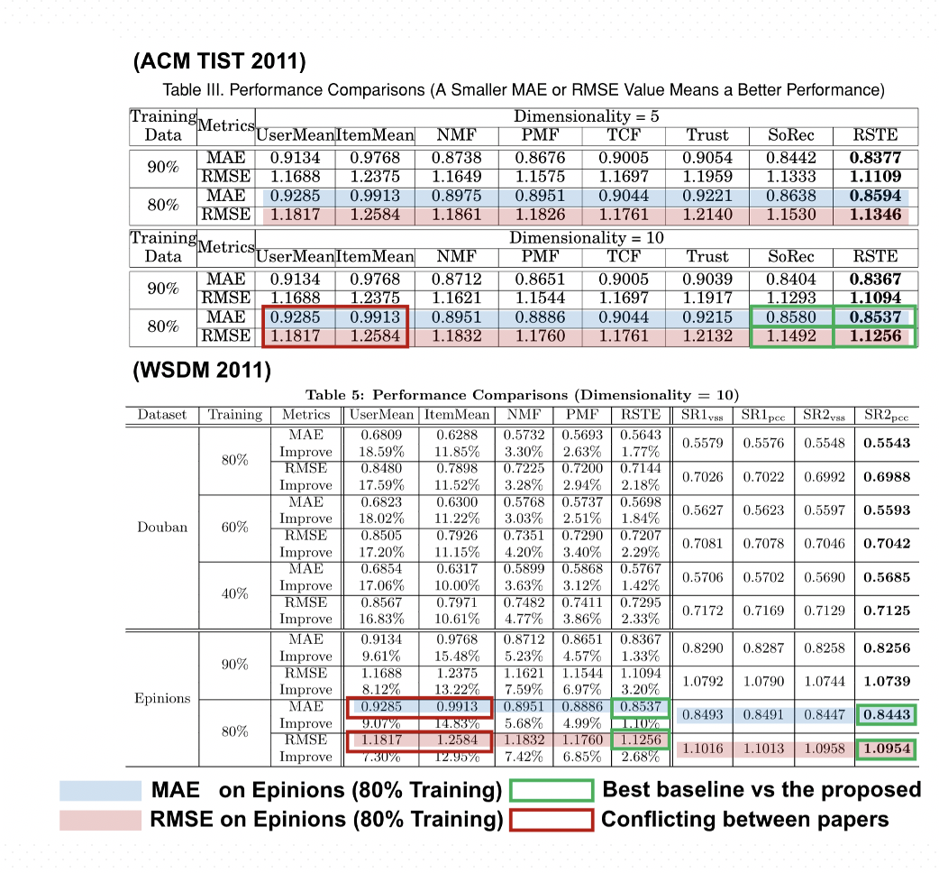
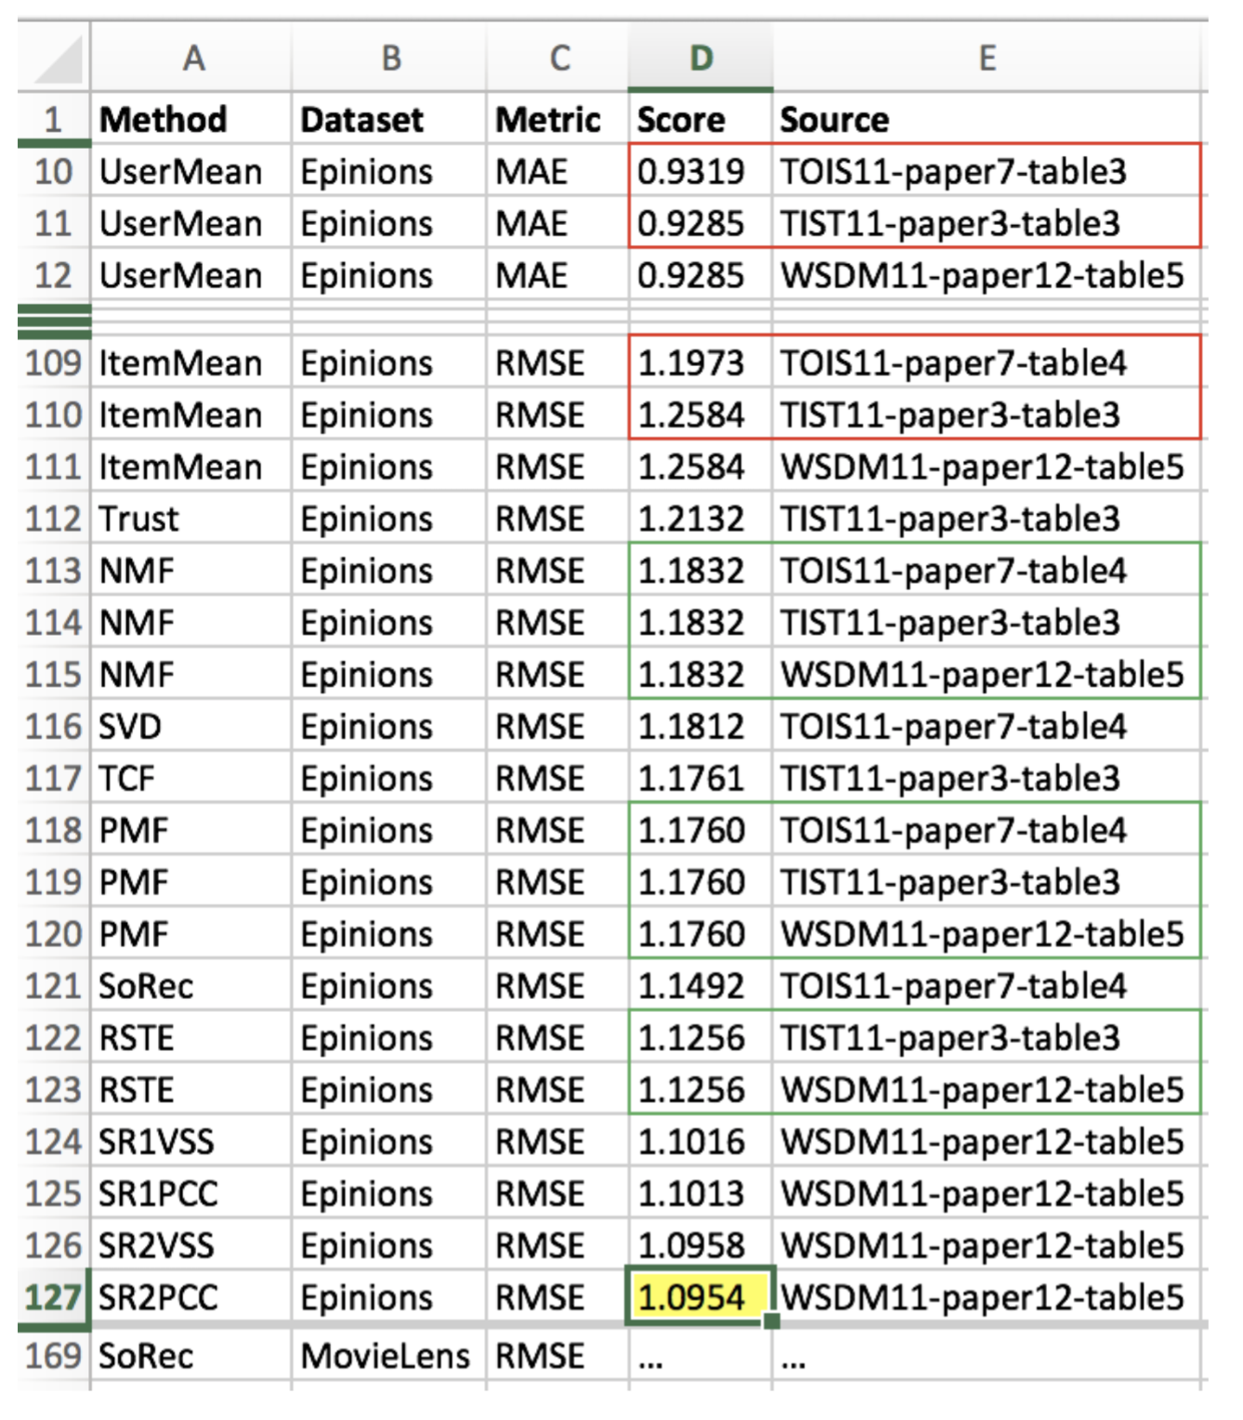









System Pipeline
PDFs in
Digital Libraries
Experimental Result
Database (ERD)
Tables in PDF
This is the most challenging task!

Slide 22
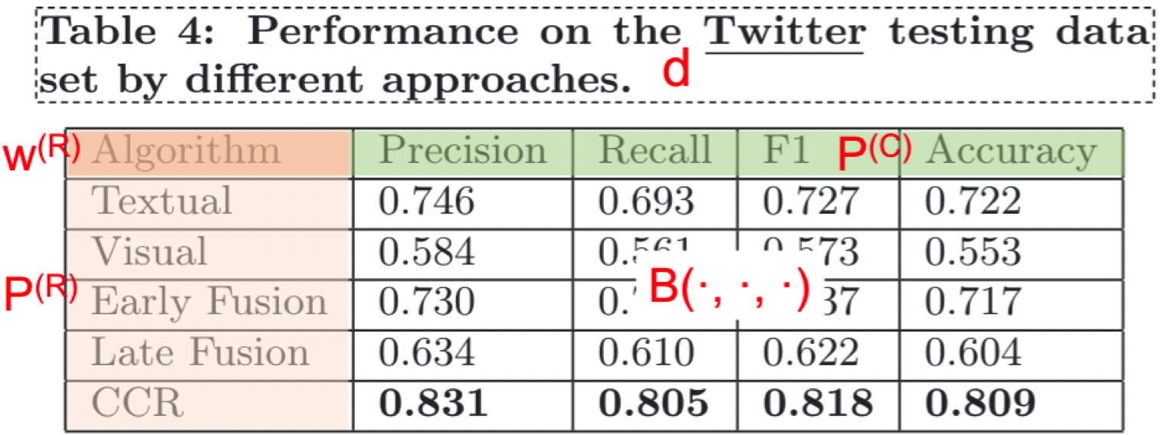
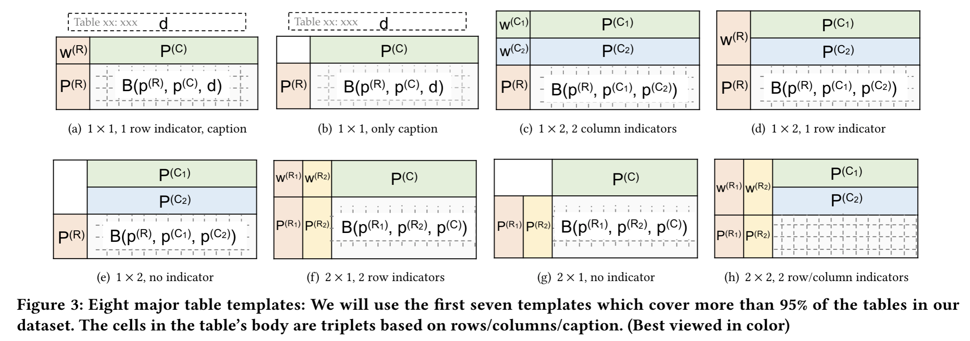
Table Components
Caption: d
Row names: P^{(R)}
Column names: P^{(C)}
Name indicator: W^{(R)}
Table body: B(P^{(R)}, P^{(C)}, d)

Slide 23
Table Templates

Slide 24
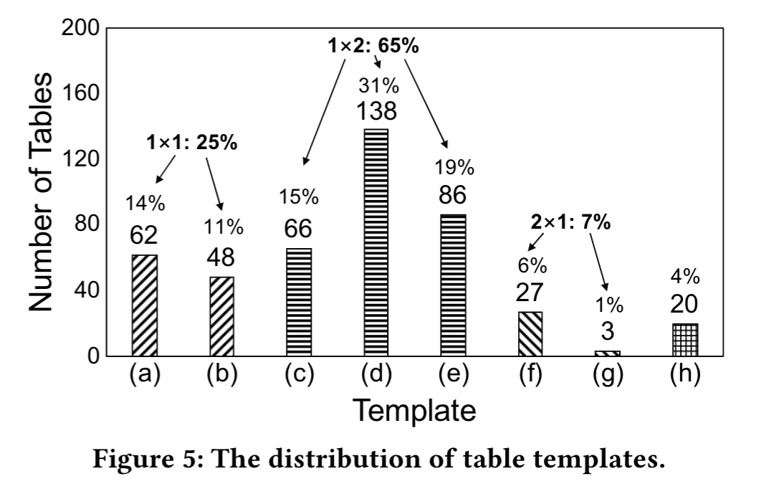
Table Templates (cont’d)
Top 2 popular templates

Slide 25
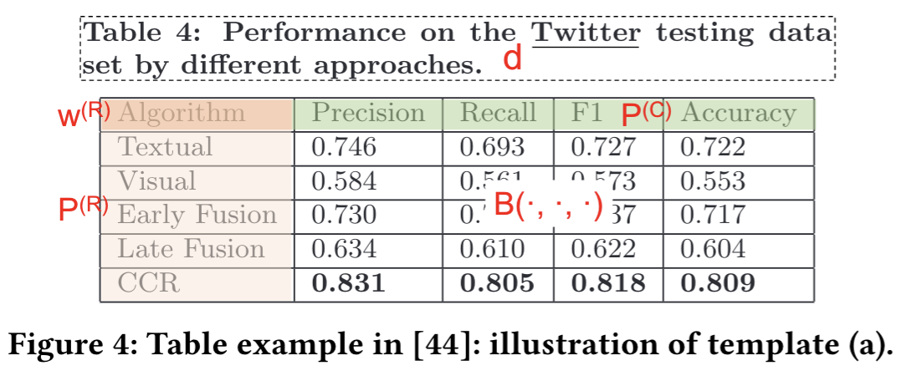
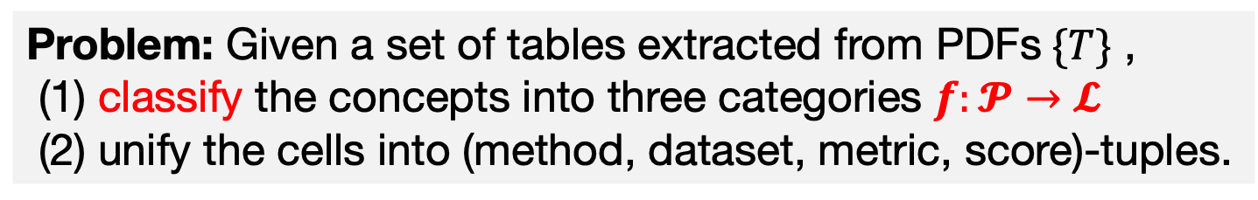
Problem Definition
Dataset | Method | Metric | Score
Twitter | Textual | Precision | 0.746
Twitter | Textual | Recall | 0.693
… | … | … | …
Twitter | CCR | F1 | 0.818
Twitter | CCR | Accuracy | 0.809
Problem: Given a set of tables extracted from PDFs$\{T\}$ ,
(1) classify the concepts into three categories $f:𝓟→𝓛$
(2) unify the cells into (method, dataset, metric, score)-tuples.

Slide 26
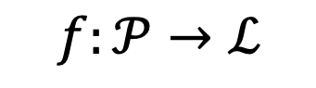
Ensemble Learning
Concept-to-Label
$f:𝒫→ℒ$
Rule-based classifiers
Three Assumptions
Learning-based classifiers
Semantic concept Embeddings
Structural concept Embeddings
A1
A2
A3
E1
E2
Seeds
Run iteratively

Slide 27
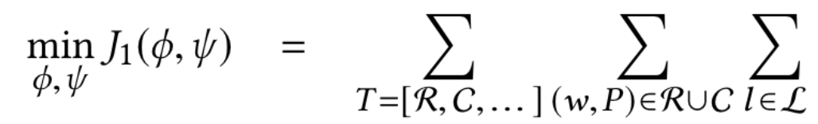
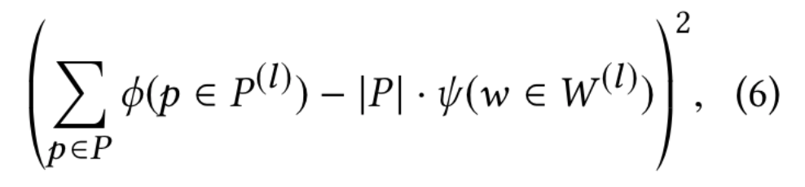


Assumption 1
Row/column header indication. If the upper-leftmost cell of the table has a specific word (e.g., “Methods”, “Algorithm”), the names on the corresponding columns/rows are more likely to have the label as the word indicates.
label prediction $φ$
word indication $ψ$

Slide 28
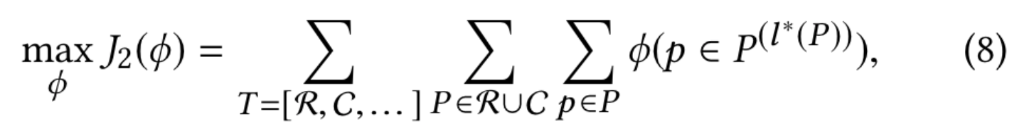
Assumption 2
Row/column type consistency. Concepts on the same column/row are likely to have the same type of label. For example, if we know “Precision” is a “metric”, then “Recall” is likely to be a “metric”.
majority of the concepts

Slide 29
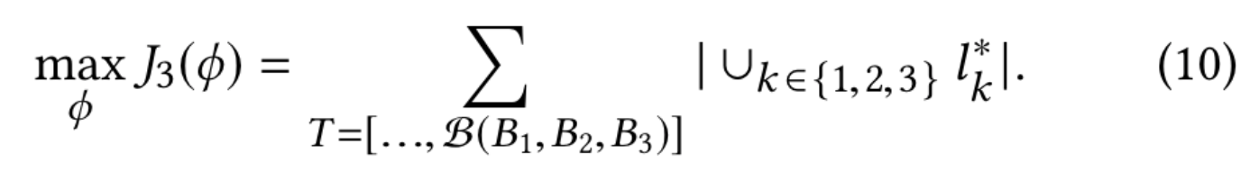
Assumption 3
Cell context completeness. A table often covers all the three types of labels on its columns, rows, and caption, in order to provide complete contexts to explain the values in the cells. For example, if the caption has a dataset name and row names are methods, then the column names are likely to be metric.

Slide 30
Learning-based Classifier
Semantic concept embeddings (BERT^{[1]})
Seen Concepts
[Paper text] On the other hand, the proposed CCR model can improve the performance of both precision and recall than the two single models. Meanwhile, CCR performs best among all the methods in terms of both F1 and accuracy score.
LEMON
Method
Amazon
Dataset
Precision
Metric
Structural concept embeddings (HEBE^{[2]})
…
…
Unseen Concepts
LEMON
CCR
?
F1
0.953
Twitter
?
0.727
…
…
Amazon
Twitter
CCR
[1] Devlin et al., BERT: Pre-training of Deep Bidirectional Transformers for Language Understanding. In NAACL 2019.
[2] Gui et al., Embedding learning with events in heterogeneous information networks. In TKDE 2017.

Slide 31
Review: Tablepedia System

Slide 32
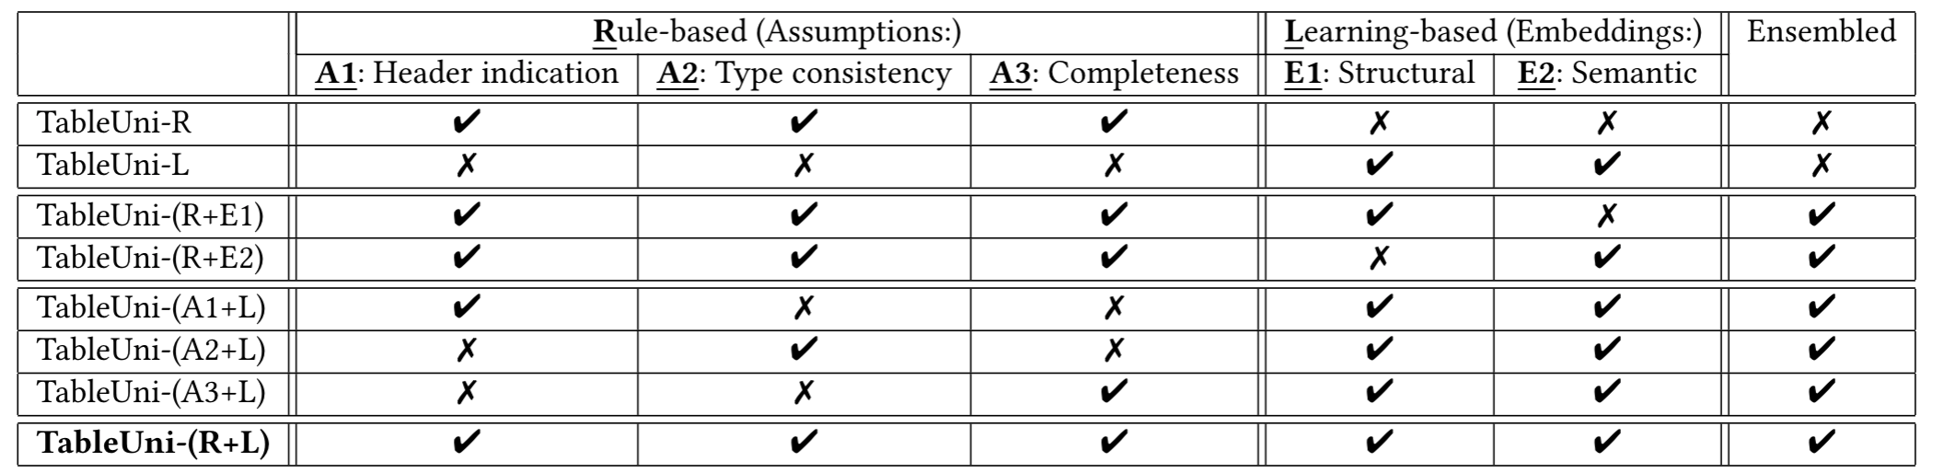
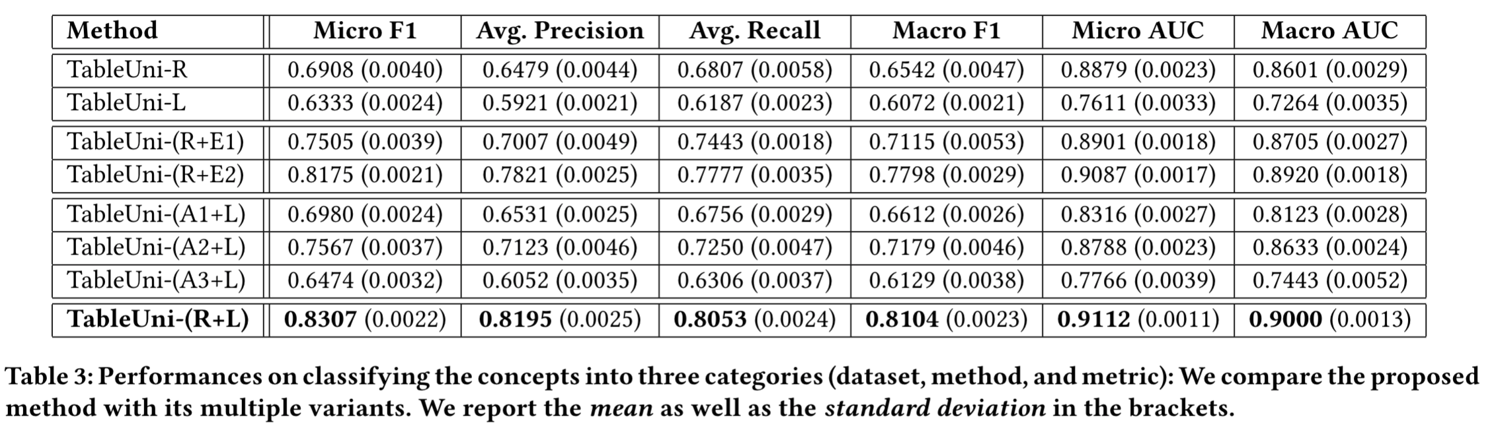
Results
Semantic embedding is more effective than structural.
R > L
Rule is better than Learning.
E1 > E2
A2 > A1 > A3
Type consistency
is the most effective.
R+L is the best!
Using all the Five (Three plus Two) is the best!

Slide 33
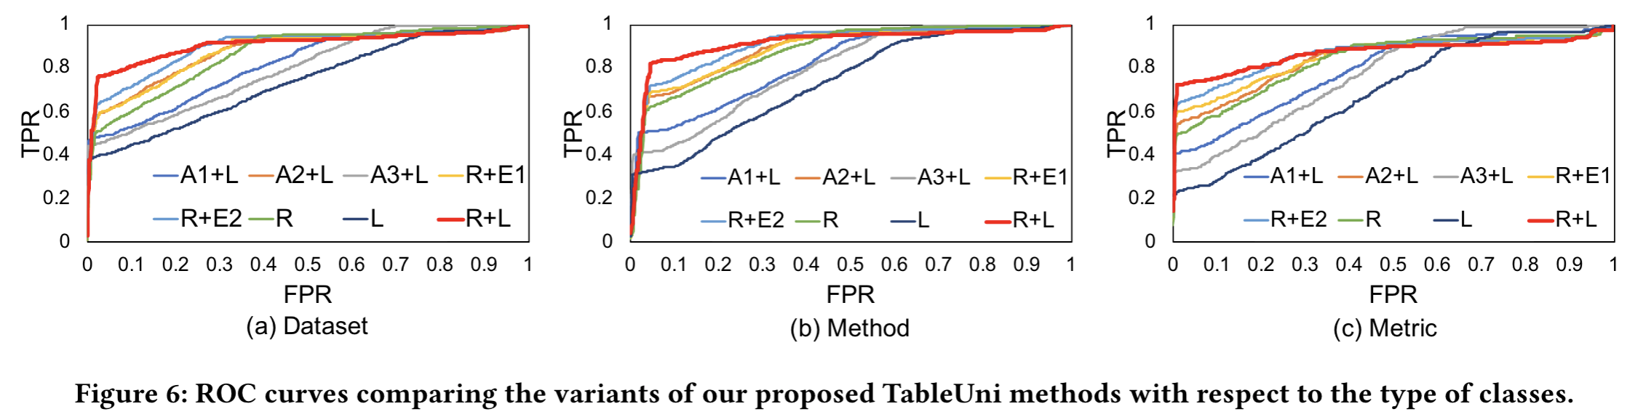
Results (cont’d)
Rule is better than Learning.
Type consistency (Rule 2) is the most effective.
Semantic embedding is more effective than structrual embedding.
Rule + Learning is the best!

Slide 34
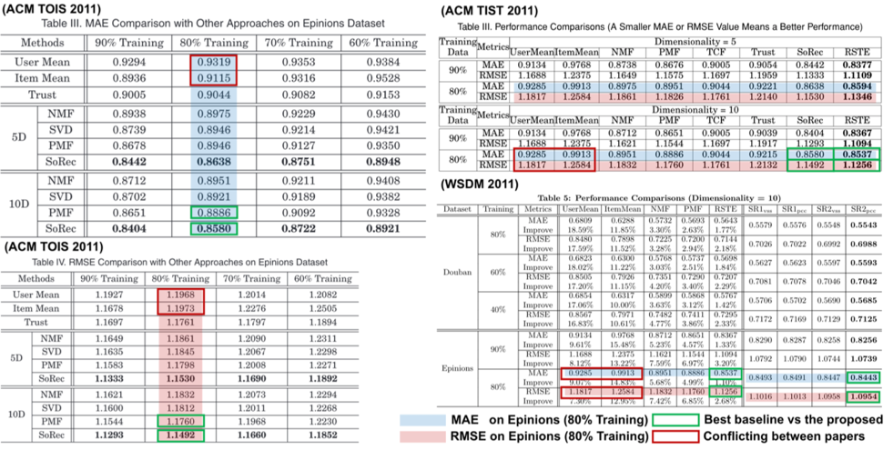
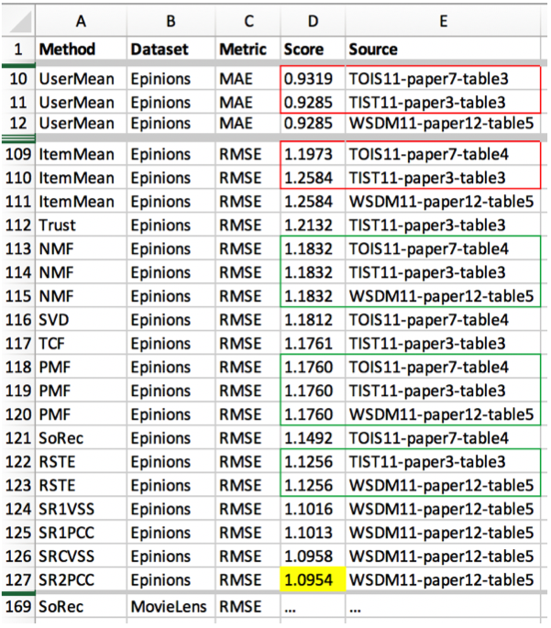
Results (RecSys)

Slide 35
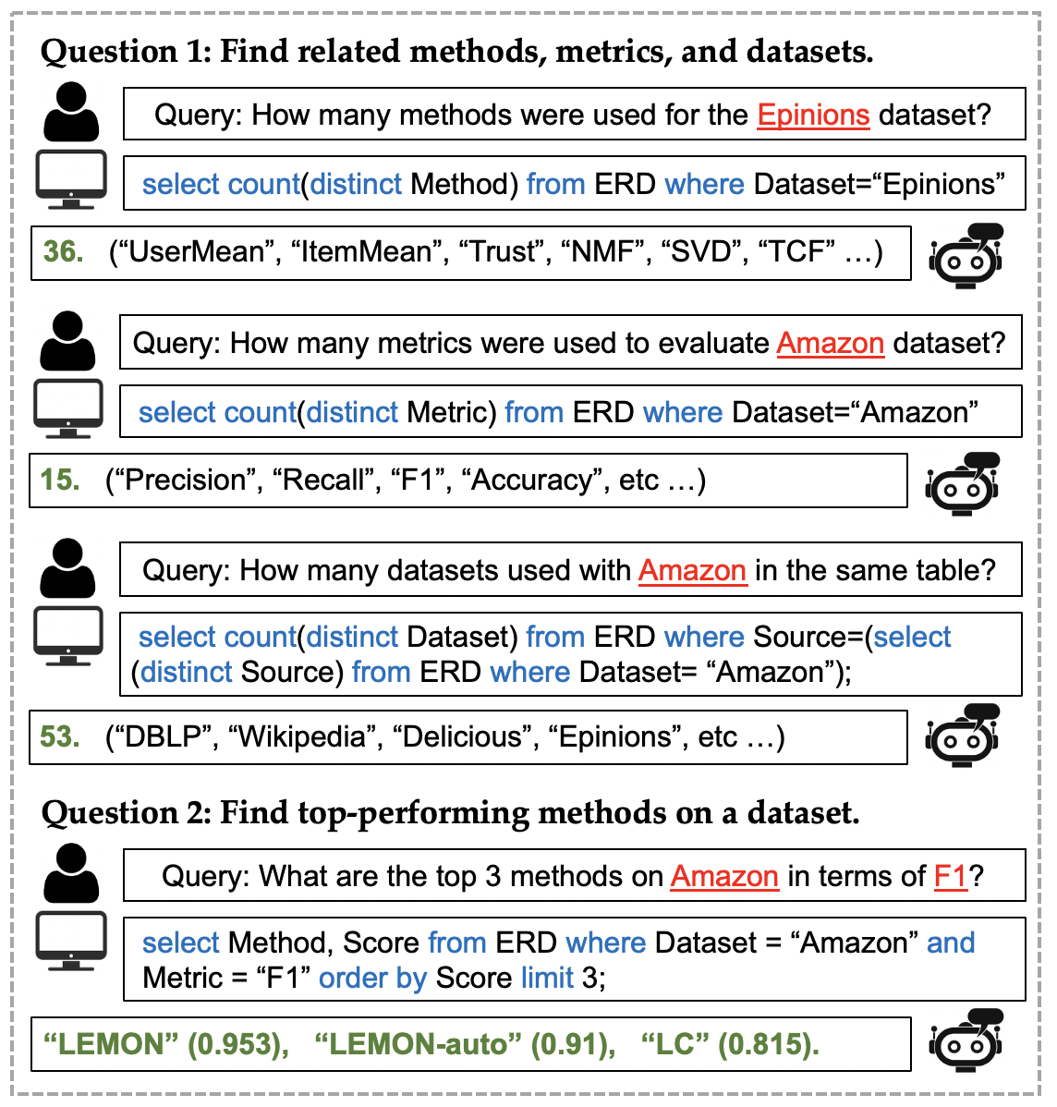
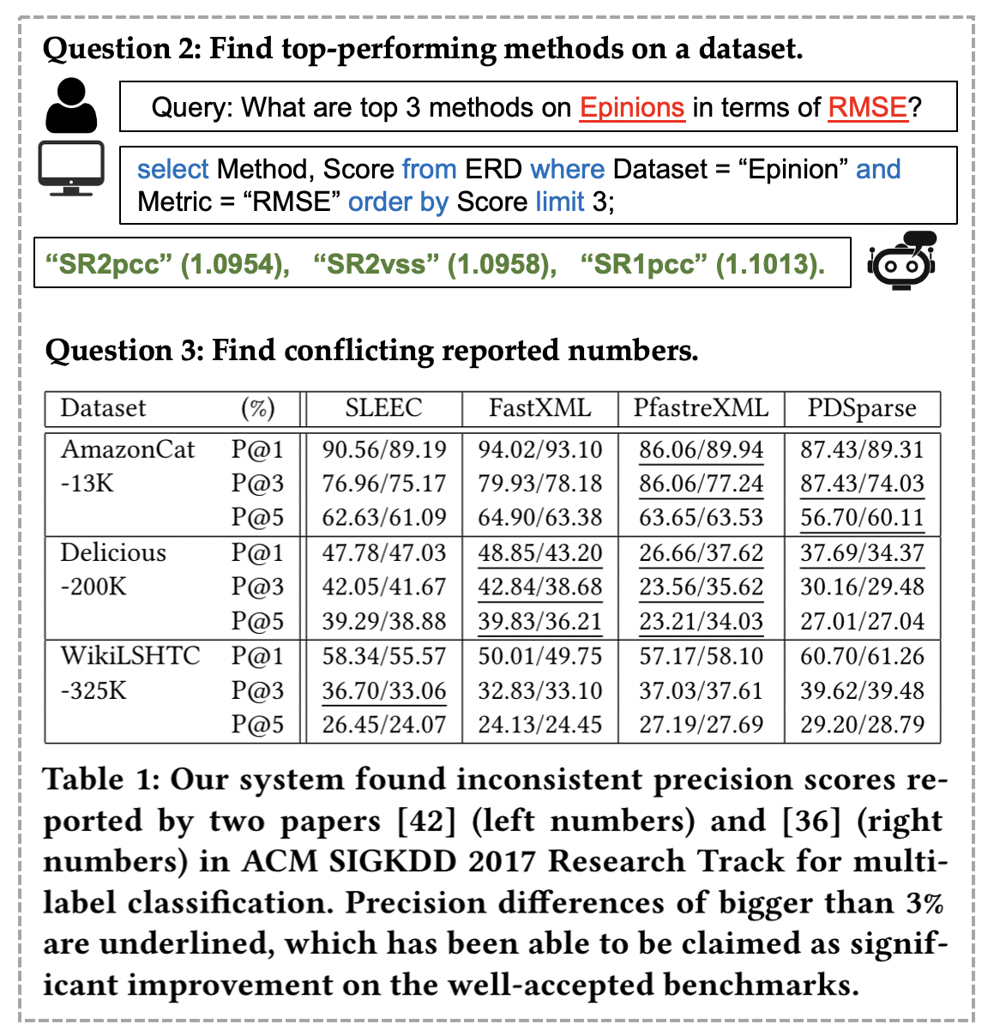
Results: Asking ERD

